Slide 1
Conserving Energy

Slide 2
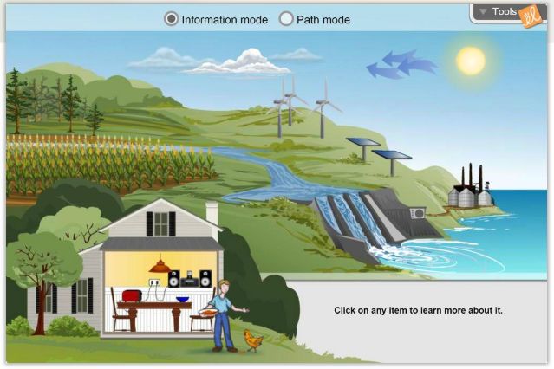
Let’s Review Energy Conversion

Slide 4
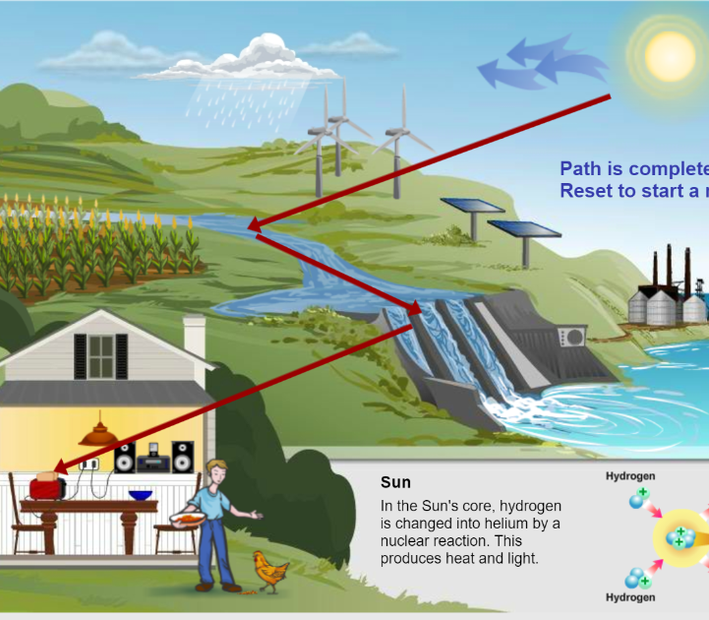
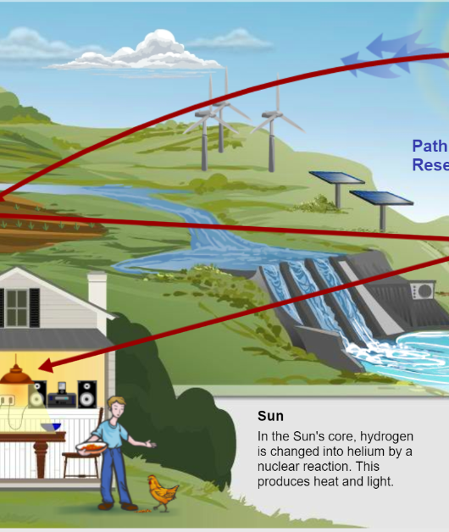
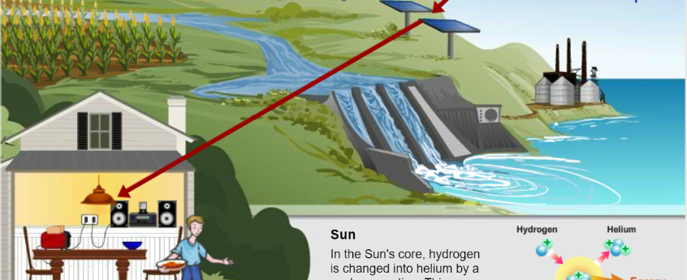
You try! Draw the energy path.

Slide 5
Today’s Goal
Students will be able to compare/contrast different sources of energy and make an informed decision about which energy source is best for the imaginary town of Power City.

Slide 6
Wasting Energy

Slide 7
How can we save energy in our homes?

Slide 8
How can we save energy in at school?

Slide 9
You create the future solutions
Oil will run out by 2081.

